Slide 1
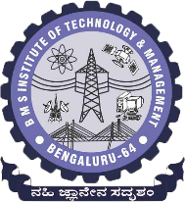
 | BMS INSTITUTE OF TECHNOLOGY & MANAGEMENT, YELAHANKA, BANGALORE. Department of Computer Science & Engineering
HAND GESTURE RECOGNITION FOR HUMAN COMPUTER INTERACTION (HCI)
ABHISHEK B – 1BY15CS005
Kanya krishi - 1BY15CS035
MEGHANA M - 1BY15CS049
MOHAMMED DAANIYAAL - 1BY15CS051
Under the guidance of:
DR.ANUPAMA HS
ASSOCIATE PROFESSOR, CSE
BMSIT&M

Slide 2
abstract
Hand gesture recognition is to interpret the human gestures using certain mathematical algorithms for computer interaction.
It enables the humans to interact with the machine directly without any means of mechanical devices thereby improving the work efficiency of the machine used.
In our project hand gestures are used to train the model and perform certain actions like scrolling down a page, scrolling up a page, zooming in, and zooming out.
The gestures are recorded in real time and sent to the model trained using convolutional neural networks (CNN) which sorts the gestures and maps them to their corresponding actions.
PyAutoGUI is used to control the PDF or book using the commands that are generated based on the respective hand gestures made.

Slide 3
introduction
Gestures are the actions that commonly originate from any bodily motion, but usually they can be originated from the face or the hand. These gestures are helpful in communicating meaningful messages by the user.
A hand gesture recognition system can be developed in order to capture the hand gestures that are being performed by the user, analyse them further to control the system based on the information gained from the analysis.
The hand gesture recognition system for human computer interaction uses OpenCV for gesture recognition and Convolutional neural network (ConvNets or CNNs) for training the model in use.
It takes in gestures such as the palm for zooming in, the fist for zooming out, a swing of the hand turns the pages towards the right and the peace sign turns the pages towards the left.

Slide 4
OBJECTIVE
The main objective of our proposed system is to detect hand movements / gestures.
Detect the gestures by training the system on a dataset using neural networks and machine learning techniques.
Perform different actions such as switching of pages, zooming in or zooming out of pages, etc based on different gestures detected.
Perform the actions without interaction with the physical hardware such as keyboard and mouse.

Slide 5
SYSTEM REQUIREMENTS SPECIFICATION
HARDWARE REQUIREMENTS:
Web Camera: 10 Megapixels or higher
Processor: Intel Core i5 or higher
Graphical Processing Unit (GPU): 4 GB
Memory: 25 GB Disk Space
SOFTWARE REQUIREMENTS
Programming Language | Python 3.6
Operating System | Windows / Linux / Mac OS.
Anaconda | Anaconda is an open-source distribution of the Python and R programming language.
IDE | Spyder 3.3.4
OpenCV | A real time computer vision library.
NumPy | Python package for scientific computing.
Scikit - learn | Python library for machine learning.
TensorFlow | It is a open-source software machine learning library.
TFlearn | It’s a modular and transparent deep learning library built on top of Tensorflow.
PyAutoGUI | Used to programmatically control the mouse & keyboard.

Slide 6
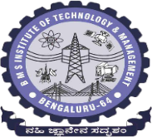
LITERATURE SURVEY
SL.NO | AUTHOR, TITLE AND YEAR OF PUBLICATION | METHODOLOGY | ADVANTAGES | LIMITATIONS
1. | Meenakshi Panwar, Pawan Singh Mehra, Hand Gesture Recognition for Human Computer Interaction. | The implementation is divided into four main steps: 1.Image Enhancement and Segmentation 2.Orientation Detection 3.Feature Extraction 4.Classification. | The proposed and implemented algorithm does not require any kind of training of sample data. It takes a less computation time as compare to other approaches. | Its main limitation is that different light condition leads to change of colors very rapidly, which may cause error or even failures.
2. | Rafiqul Zaman Khan and Noor Adnan Ibraheem, Comparitive Study Of Hand Gesture Recognition System. | Three main steps in this system 1. Segmentation 2. Feature Representation 3.Recognition Techniques It has an accuracy of 85.83%. | Recognises gestures from both 2D and 3D images. Different groups of features are examined to decide the good performance group. | It doesn’t consider motion gestures. It is unable to classify images with complex background The computation time is high(2-4s).
3. | Arpita Ray Sarkar G. Sanyal S. Majumder Hand Gesture Recognition Systems: A Survey. | The phases are: 1.Data acquisition, 2.Hand segmentation and pre-processing, 3.Feature extraction and finally 4.the recognition. | It provides a brief description of all the gesture modelling algorithms used. Lists the various input and sensor devices available. | When there is a change in the illumination condition, the system fails to recognize properly The system fails to recognize if the hand is orientated in a different angle. Special hardwares are required

Slide 7
SL.NO | AUTHOR, TITLE AND YEAR OF PUBLICATION | METHODOLOGY | ADVANTAGES | LIMITATIONS
4. | Manjunath A E, Vijaya Kumar B P, Rajesh H Comparative Study of Hand Gesture Recognition Algorithms. | The phases are: 1.Hand gesture recognition using kinect camera 2.Edge Detection 3.Hand Gesture recognition. | This system captures the gestured image and compares it with the predefined images in the database. On finding a match, it outputs the number which the gesture signifying. | The edge detection and segmentation algorithms used here are not very efficient when compared to neural networks. The dataset is very small . The histogram matching method is not very reliable and can give false output at times.
5. | Dnyanada R Jadhav, L. M. R. J Lobo, Navigation of PowerPoint Using Hand Gestures. | The System architecture consists of 1.Image acquisition 2.Segmentation of hand region. 3.Distance transform method for gesture recognition. | 1.Distance transform method is better in performance than circular profiling method. 2.The presented gesture recognition system recognizes both static and dynamic gestures. | The limitations are: 1.The number of gestures that are recognized are less. 2.The gestures where not used to control any applications.

Slide 8
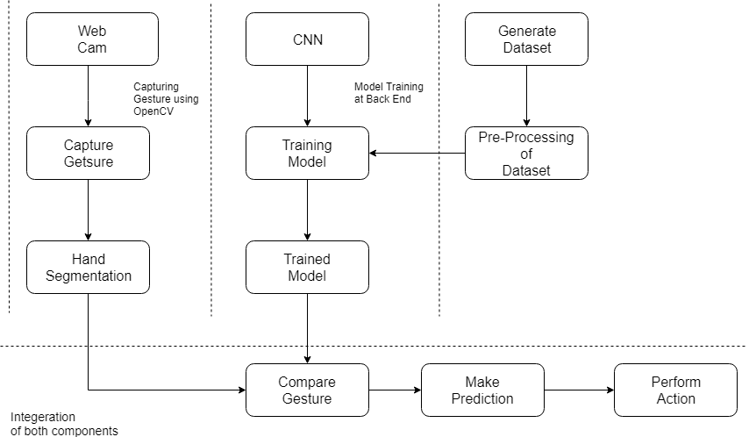
System design
Architectural Design
The main components are
OpenCV - to detect the hand gesture
CNN to train the model.

Slide 9
2. Data Flow Diagram (DFD)
Level 0 DFD
The DFD shows the system used – Hand Gesture Recognition System, the input – Hand movement and the output – Action performed.
Level 1 DFD
There are three main modules in our system – Capture Gesture, Predict Gesture and the Human Computer interaction..

Slide 10
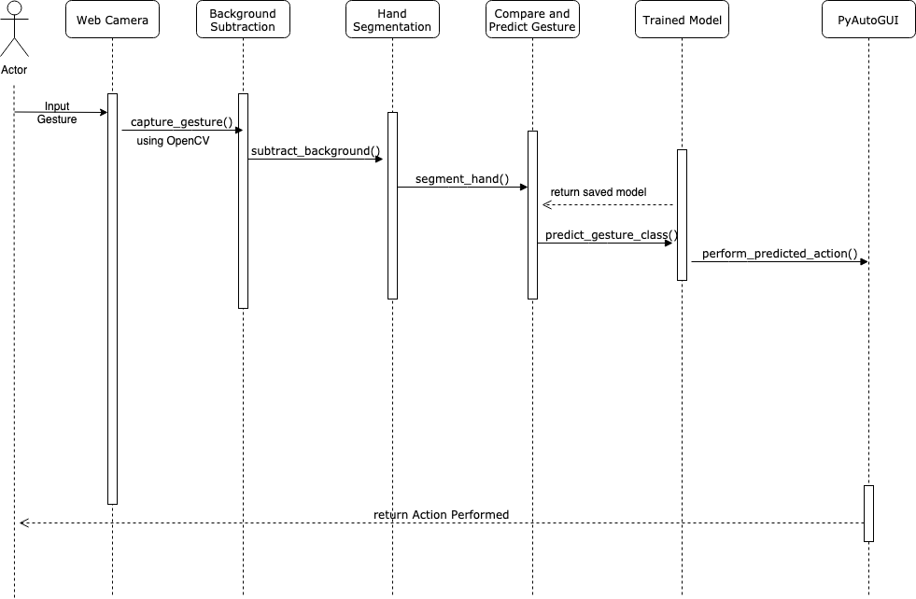
3. Sequence Diagram

Slide 11
IMPLEMENTATION
TOOLS USED
OpenCV | It is an open source computer vision and machine learning software library. We can develop real-time computer vision applications using this. It mainly focuses on image processing, video capture and analysis including features like face detection and object detection.
NumPy | It is the fundamental package for scientific computing in Python. It provides routines for fast operations on arrays, including mathematical, logical,discrete Fourier transforms, basic linear algebra and more.
Tensor Flow | It is an open-source software library for dataflow and differentiable programming. It is a symbolic math library, and is also used for machine learning applications such as neural networks.
Pyauto GUI | You can control the mouse and keyboard as well as perform basic image recognition to automate tasks on your computer.
DATA STRUCTURES USED
NumPy arrays | They have a fixed size at creation. Changing the size of an array will create a new array and delete the original. It facilitates advanced mathematical and other types of operations on large numbers of data.
Python dictionaries | It is an unordered collection of data values, used to store data values as a key value pair.
Python lists | It is used to store multiple data at the same time. The list in Python are ordered and have a definite count. The elements in a list are indexed.

Slide 12
IMPLEMENTATION
Algorithm
The CNN is designed using TensorFlow.
The network contains 1 input layer, 7 hidden convolution layers with Relu as the activation function and 1 Fully connected layer.
The model is trained using this network for four gestures.
The gesture is captured using a webcam and is pre-processed.
This gesture is compared to the trained model and a prediction is made.
This prediction is used to perform actions using PyAutoGUI.

Slide 13
IMPLEMENTATION
Functions
The main functions that are used are:
resizeImage()
run_avg()
segment()
getPredictedClass()
showStatistics()
main()
The gestures indicate the following:
Palm is used for performing zoom in operation at runtime.
Fist is used for performing zoom out operation at runtime.
Swing is used for performing turning right operation at runtime.
Peace is used for performing turning left operation at runtime.

Slide 14
IMPLEMENTATION
Walkthrough of the project
i. Generation of dataset: The dataset is generated by running the PalmTrack.py file.
ii. Resizing of Images: The resizeImage() function resizes the images since the network accepts only images of size 89*100 pixels.
iii. Training the model using Convolutional Neural Network (CNN): the dataset is fed into this network for training. The network contains 1 input layer, 7 hidden convolution layers with Relu as the activation function and 1 Fully connected layer.
iv. Running the Project: Running the run.py file opens up your webcam and takes continuous frames of your hand image and then predicts the class of your hand gesture in real time.

Slide 15

TESTING
Test Case Id | Description | Expected Result | Result
U_TC_001 | Loading the dataset | Load the images and the labels of the training and test dataset into python lists. | Pass
U_TC_002 | Training the convolutional neural network (CNN) and save the model, | Generate a model on the dataset trained and save a model file. | Pass
U_TC_003 | Gesture recognition and prediction | Capture the frame, recognise the gesture shown by the user in the region of user and predict it (right, left, zoom-in and zoom out). | Pass
I_TC_001 | Loading the dataset and Training the convolutional neural network (CNN) | The images loaded into the python lists to be used as input data to the convolutional neural network. | Pass
I_TC_002 | Loading the trained model, opening the web camera, drawing the region of interest, gesture recognition and prediction and PyAutoGUI | Load the saved model, draw a bounding box in the region of interest on the frame, recognise and predicted gesture is sent to the PyAutoGUI module to perform the corresponding action. | Pass
S_TC_001 | Zoom – in (Palm) | Zoom in of the page. | Pass
S_TC_002 | Zoom – out (Fist) | Zoom out of the page. | Pass
S_TC_003 | Right (Swing) | Turn the page right or switch to the next page. | Pass
S_TC_004 | Left (Peace) | Turn the page left or switch to the previous page. | Pass
S_TC_005 | Any random gesture | No action should be performed | Fail
Hand Gesture Recognition For Human Computer Interaction

Slide 16
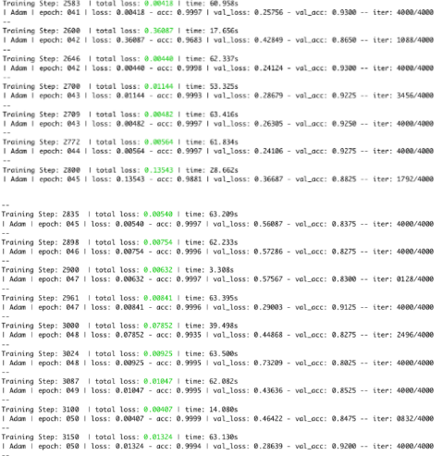
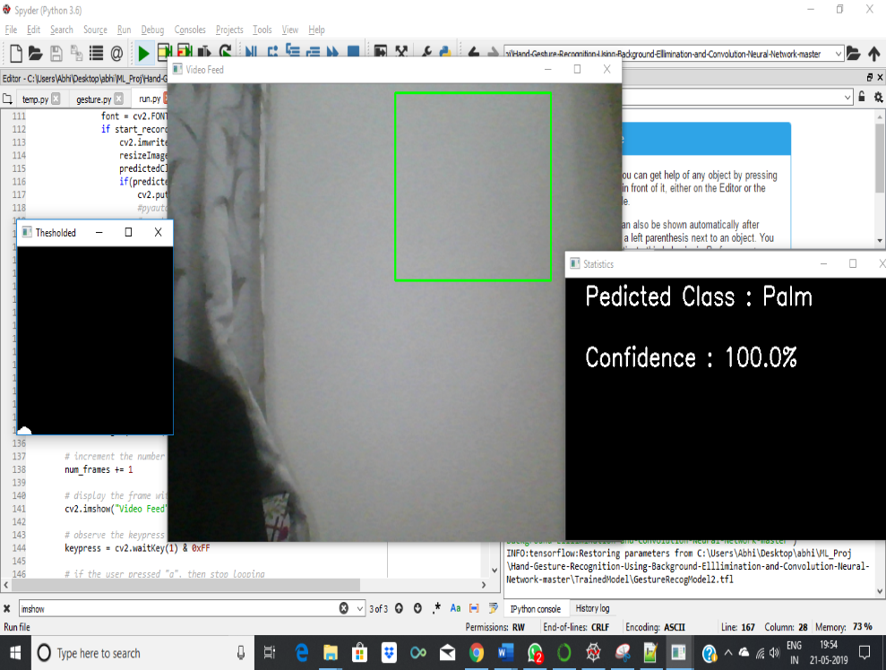
RESULTS AND ANALYSIS
The dataset was generated with background subtraction.
There are 1000 training images and 100 test images for each gesture.]
The model was trained for 50 epochs.
The model achieves an accuracy of 99.4% on the training dataset and an accuracy of 92% on the test dataset.
Training the model
Display of windows

Slide 17
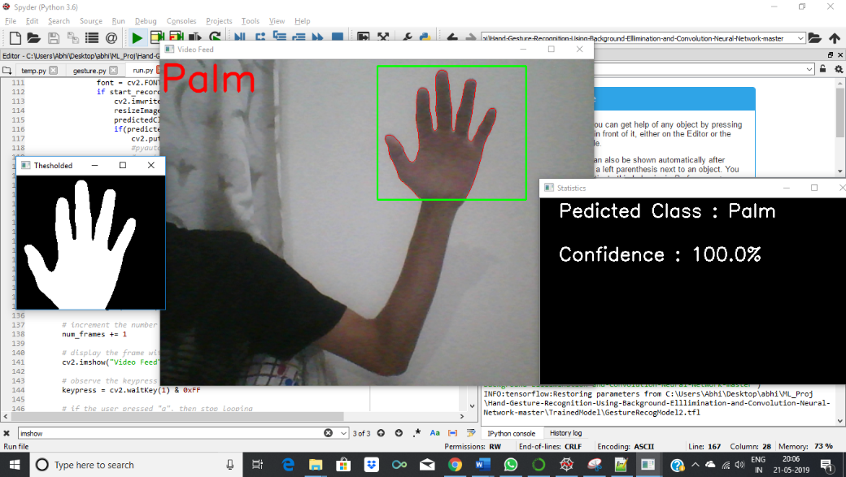
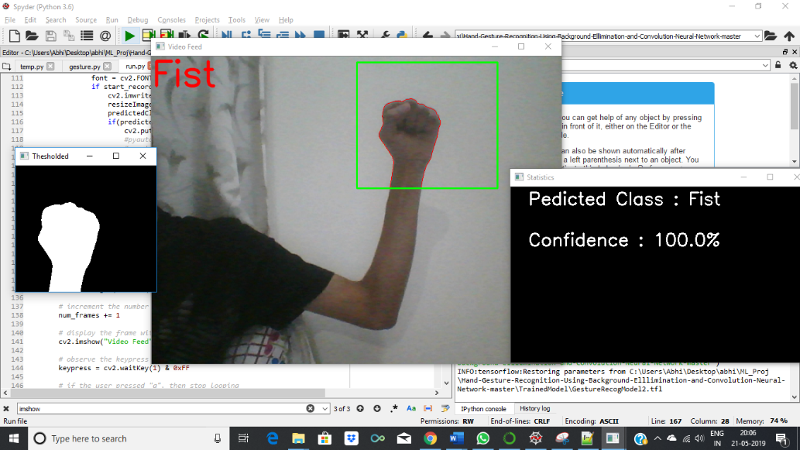
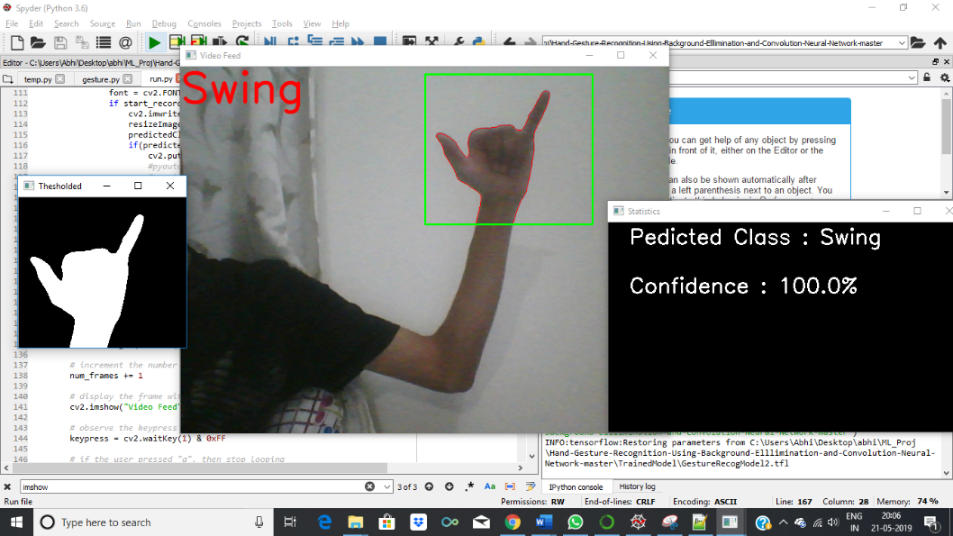
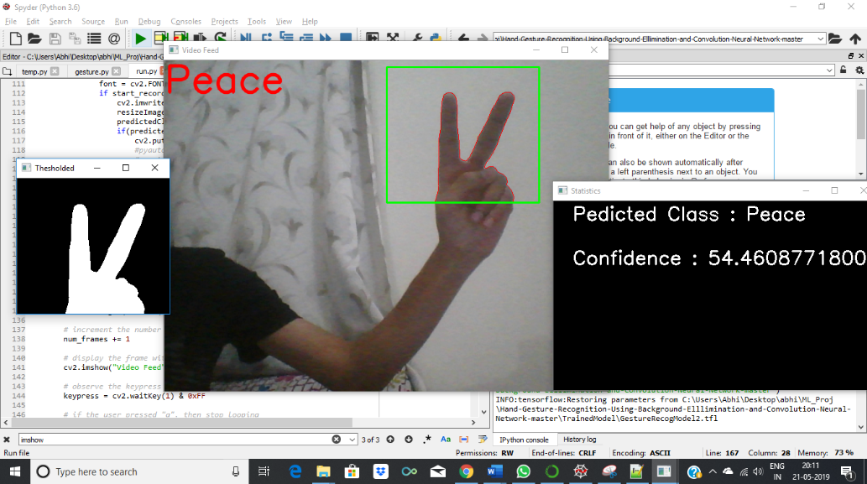
RESULTS AND ANALYSIS
Prediction of Palm Gesture (Zoom In) Prediction of Fist Gesture (Zoom Out)
Prediction of Swing Gesture (Right) Prediction of Peace Gesture (Left)

Slide 18
CONCLUSION AND
FUTURE ENHANCEMENT
The application of the project are in various areas such as :
Automated homes
Making presentations
Gaming
Switching T.V channels
Internet of Things (IOT)
As part of the future work and enhancement the following can be implemented :
More number of gestures
Extending to dynamic gestures such as swiping left and right
Better accuracy and efficiency
Moving through multiple pages

Slide 19
REFERENCES
[1] Meenakshi Panwar, Pawan Singh Mehra, Hand Gesture Recognition for Human Computer Interaction, International Conference on Image Information Processing India (2011).
[2] Rafiqul Zaman Khan and Noor Adnan Ibraheem, Comparitive Study Of Hand Gesture Recognition System, AIRCC Digital Library
[3] Arpita Ray Sarkar ,G. Sanyal , S. Majumder ,Hand Gesture Recognition Systems: A Survey ,International Journal of Computer Applications Volume 71– No.15, May 2013.
[4] Manjunath A E ,Vijaya Kumar B P , Rajesh H, Comparative Study of Hand Gesture Recognition Algorithms, International Journal of Research in Computer and Communication Technology, Vol 3, Issue 4, April- 2014.
[5] Dnyanada R Jadhav, L. M. R. J Lobo, Navigation of PowerPoint Using Hand Gestures , International Journal of Science and Research (IJSR) 2015.
[6] Ruchi Manish Gurav, Premanand K. Kadbe, Real time finger tracking and contour detection for gesture recognition using OpenCV, IEEE Conference May 2015, Pune India.
[7] Pei Xu, Department of Electrical and Computer Engineering, University of Minnesota, A Real-time Hand Gesture Recognition and Human-Computer Interaction System, Research Paper April 2017.
[8] P.Suganya, R.Sathya, K.Vijayalakshmi , Detection and Recognition of Gestures To Control The System Applications by Neural Networks, International Journal of Pure and Applied Mathematics 2018.

